Slide 1
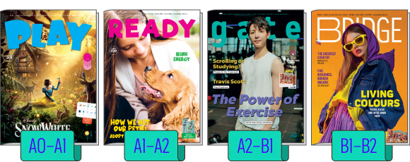
Časopisy - moderný a kvalitný doplnkový materiál na výučbu angličtiny na školách
Mgr. Michaela Zajacová, PhD.
ELT Consultant
Bridge Publishing House International
Notes:
Notes notes notes
1

Slide 2

Bridge Publishing House
od 1997 až 2,5 mil čitateľov
,,Naším cieľom je motivovať našich čitateľov, žiakov a študentov angličtiny, a pomôcť učiteľom pri vyučovaní.“
Notes:
Info o BPH: https://www.bridge-online.cz/sk/o-nas/
ČR, Slovensko
vydavatelství anglických výukových materiálů a distributor anglických učebnic
2

Slide 3




ANGLICKÉ UČEBNÉ MATERIÁLY
BRIDGE, GATE, READY a PLAY
pre žiakov a študentov od 3. triedy ZŠ po 4. ročník SŠ (po maturitu)
vychádzajú od septembra do júna v 8 vydaniach - 6 obyčajných čísel + 2 dvojčísla
Notes:
3

Slide 4
BRIDGE - MOST MEDZI ČASOPISOM A
UČEBNICIOU
VÝHODY NAŠICH ČASOPISOV NA VYUČOVANÍ
moderná metodika
časovo nenáročná príprava pre učiteľov (TF)
bohaté doplnkové materiály: TF, CD, konv. karty, online učiteľská sekcia, Kahoot
nové aktuálne témy, sezónne témy (Vianoce atď.)
novinky zo sveta filmu, hudby, videohier…
lokálne Slovenské témy
Interaktivita (Kahoot, audio, video cez QR kódy atď.)
literatúra a komiksové adaptácie literárnych diel
CLIL a medzipredmetové vzťahy
príprava na jazykové testy a maturitu
rozvoj čitateľskej gramotnosti a kritického myslenia
učenie sa hrou - zábavná forma
súťaže
LEPŠÍ NEŽ VOľNE DOSTUPNÉ ZDROJE NA INTERNETE
Notes:
Info o BPH: https://www.bridge-online.cz/sk/o-nas/
4

Slide 5
BRIDGE - MOST MEDZI ČASOPISOM A UČEBNICOU
Pripravíte sa za pár minút, učíte s
úsmevom.
Témy, ktoré žiakov vtiahnu od prvej
strany.
Od komiksov až po maturitu –
rastieme so žiakmi.
Učenie hrou, ktoré prináša výsledky.
Kompletný balík na vyučovaciu hodinu
bez stresu.
Notes:
Nabízí výhody časopisu:
Stále nová, aktuální témata, svěží a vzrušující pro studenty
Sezónní témata: svátky, tradice, výročí…
Novinky ze světa filmu, hudby a videoher…
Lokální témata z České republiky a Slovenska
Zábavná forma: jazykové hádanky, slovní hříčky
Měsíční a celoroční soutěže
Nabízí výhody učebnice:
Každý titul je pečlivě jazykově a tématicky profilovaný pro určitou věkovou skupinu a školský stupeň (školské osnovy)
Reálie anglického světa prostřednictvím anglických autorů
Nejen rozvoj čtení, také poslech (CD u každého čísla), mluvení a psaní
Zábavné procvičování gramatiky a slovní zásoby
Moderní metodika, doplňkové aktivity
Nabízí mnohem více:
Příprava na jazykové testy a maturitu
Literatura a komiksové adaptace literárních děl
CLIL a mezipředmětové vztahy
Rozvoj kritického myšlení
LEPŠÍ NEŽ VOLNÉ INTERNETOVÉ ZDROJE
LEPŠÍ NEŽ AI
Nenáročná príprava pre učiteľov - poskytujeme metodiku, cvičenia, ktoré preverujú čítanie s porozumením sú pod článkami, vhodné aj na domácu prácu pre žiakov. Časopis Vám ušetrí čas strávený hľadaním zaujímavých aktivít pre žiakov na internete.
5

Slide 6

PLAY
A0-A1 SERR - začiatočníci
3. - 5. ročník ZŠ
8 až 11 rokov
Notes:
6

Slide 7
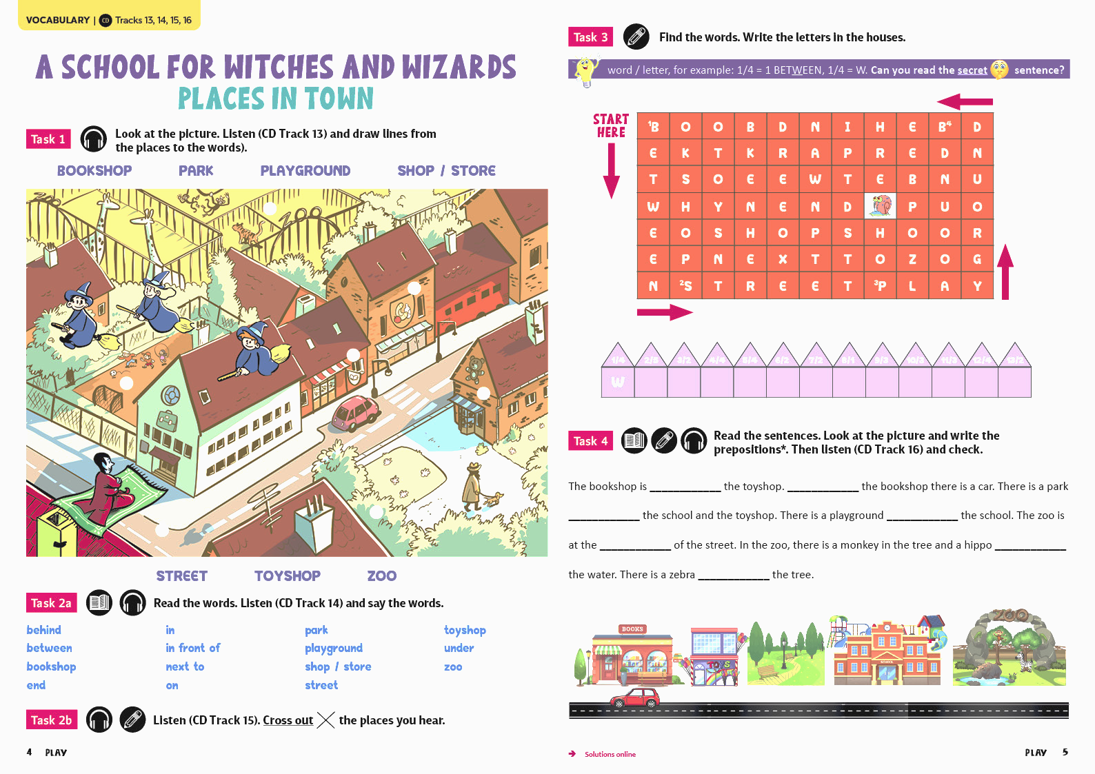
PLAY
Pomocou hry pomáhame začiatočníkom sa nadchnúť pre rozvoj angličtiny.
jazykové hry, zábavné jazykové aktivity, príbehy - dôraz na hravosť, kreativitu a zapojenie všetkých zmyslov
tematická, ucelená slovná zásoba a gramatika v každom čísle (ŠVP)
moderná metodika
dôraz na grafické prevedenie
dôraz na čítanie, počúvanie a rozprávanie
skupinové projekty
jazykové testy (A0+)
“Play exists to show young learners how English can open up new worlds.”
Anastasia Mouser (zástupca šéfredaktora PLAY)
Notes:
7

Slide 8


READY
A1-A2 SERR - pokročilí začiatočníci
5. - 7. ročník ZŠ
11 až 14 rokov
Ukážka videa - decembrový READY
Notes:
8

Slide 9
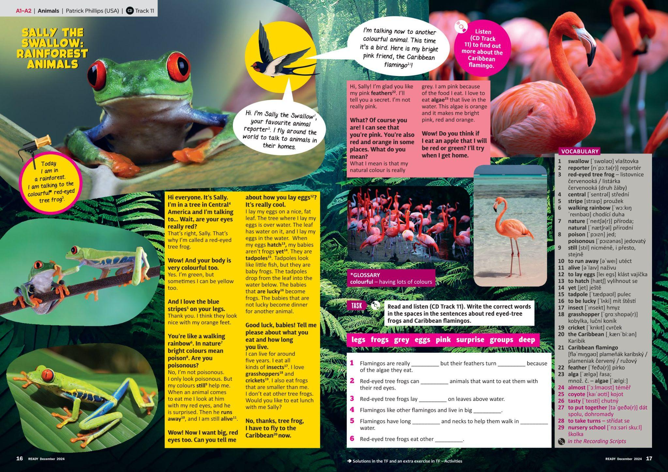
READY
Aj žiaci – pokročilí začiatočníci - zvládnu texty písané rodenými hovoriacimi.
motivujúce témy pre žiakov 2. stupňa (“preteens”): šport, technológie, zvieratá, veda, popkultúra…
reálie, sviatky a tradície zaujímavým spôsobom
tematická slovná zásoba a gramatika v každom čísle (ŠVP)
zábavné jazykové hry, príbehy, komiksovo spracovaná literatúra…
jazykové testy (A1-A2)
moderná metodika
“With READY, preteens discover the world that learning English has opened up to them.”
Anastasia Mouser (zástupca šéfredaktora READY)
Notes:
9

Slide 10


GATE
A2-B1 SERR - mierne pokročilá znalosť angličtiny
ZŠ aj SŠ
Žiaci 8. tried základných škôl – 1. ročníkov stredných škôl vo veku 14 až 16 rokov
Ukážka videa - novembrový GATE
Notes:
10

Slide 11
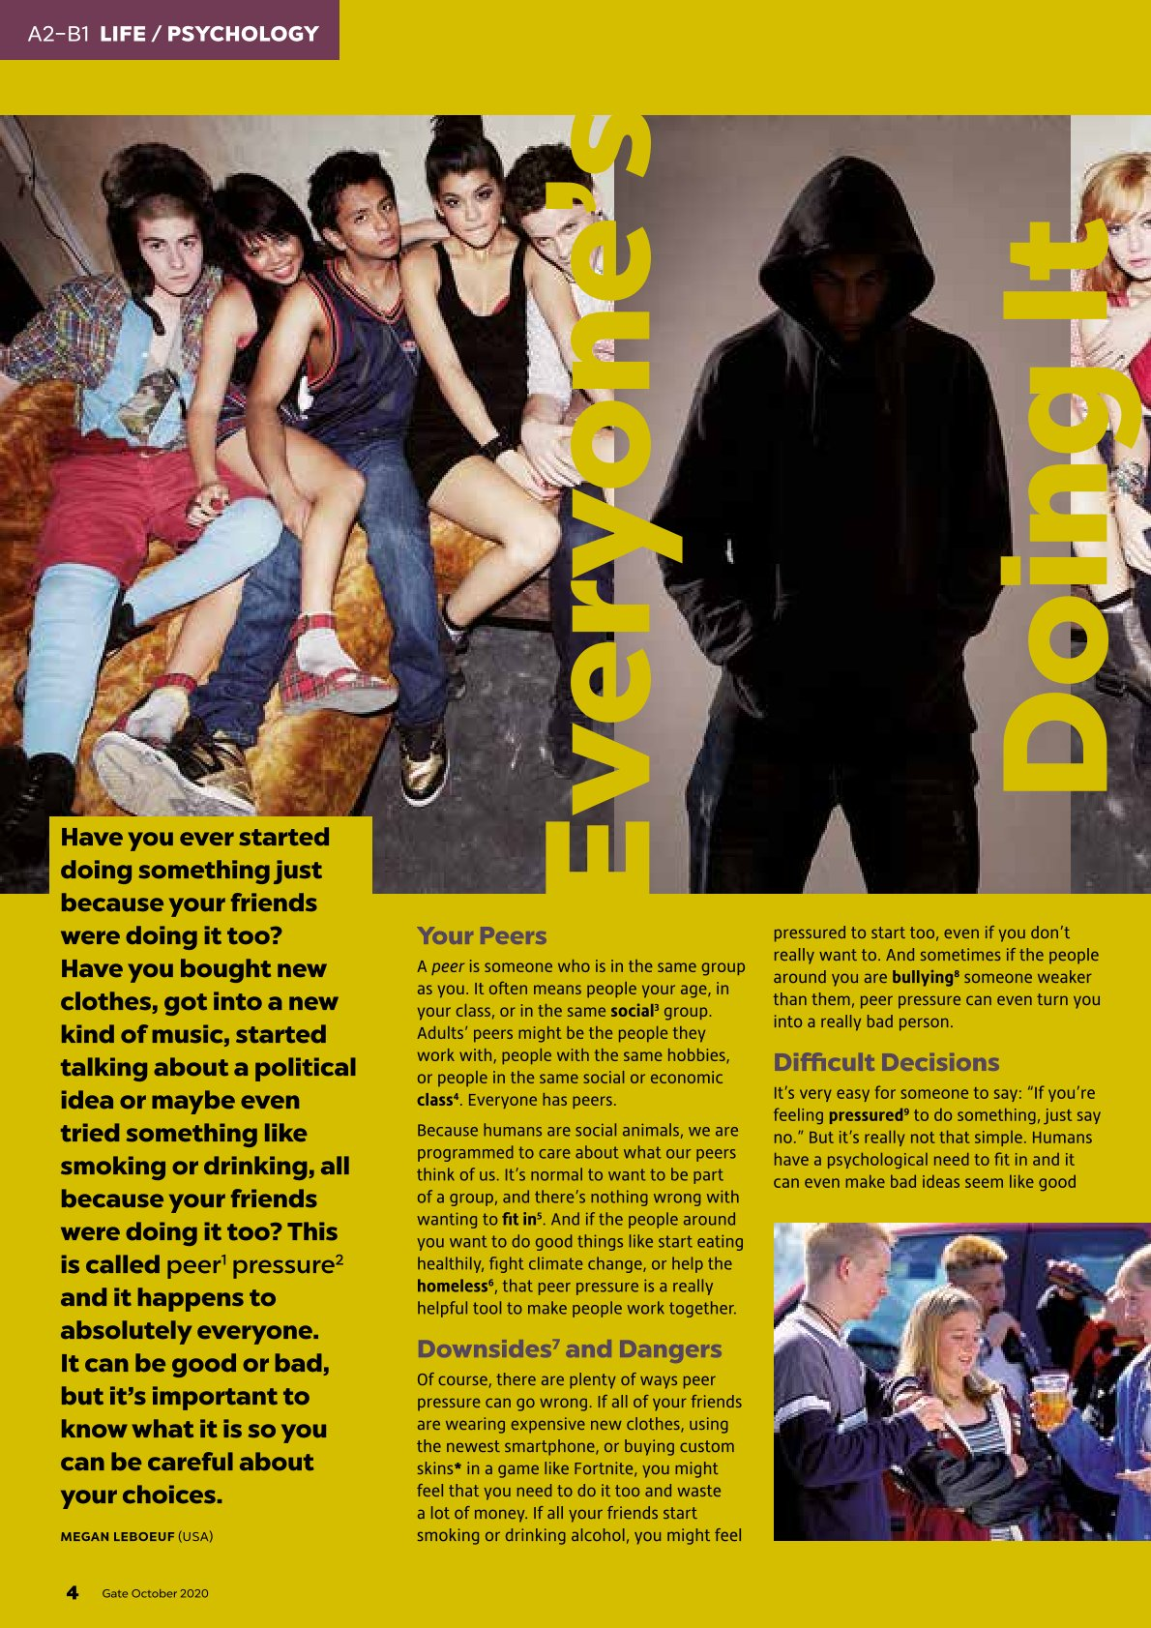
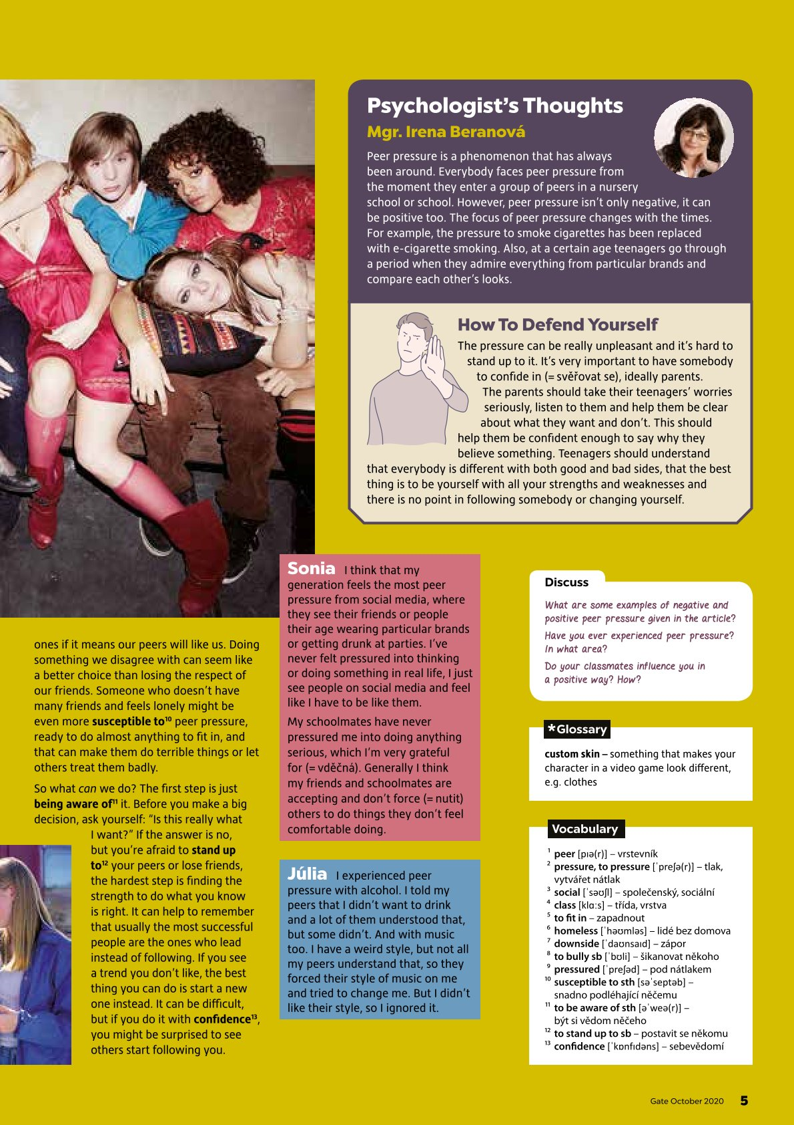
GATE
Témy a jazyk, ktorým teenageri rozumejú.
Novinky z oblastí, ktoré sú teenagerom blízke: popkultúra (hudba, film, sociálne médiá), technika, psychológia, talentovaní mladí ľudia z rôznych odborov…
Reálie, sviatky a tradície prístupným spôsobom.
Príprava na jazykové skúšky
Gramatika a slovná zásoba zábavne
Zábavné jazykové hry, príbehy, komiksovo spracovaná literatúra…
“With GATE, teenagers use their growing English skills to connect with their peers and with the wider world.”
Liam Peach (zástupce šéfredaktora GATE)
Notes:
11

Slide 12

BRIDGE CZ A SK
B1-B2 (+ C1 SERR) - stredne pokročilá znalosť angličtiny
Gymnáziá a stredné školy
Študenti a mladí dospelí vo veku 15–20 rokov (2. až 4. ročník SŠ)
Ukážka videa - októbrový BRIDGE
Notes:
12

Slide 13

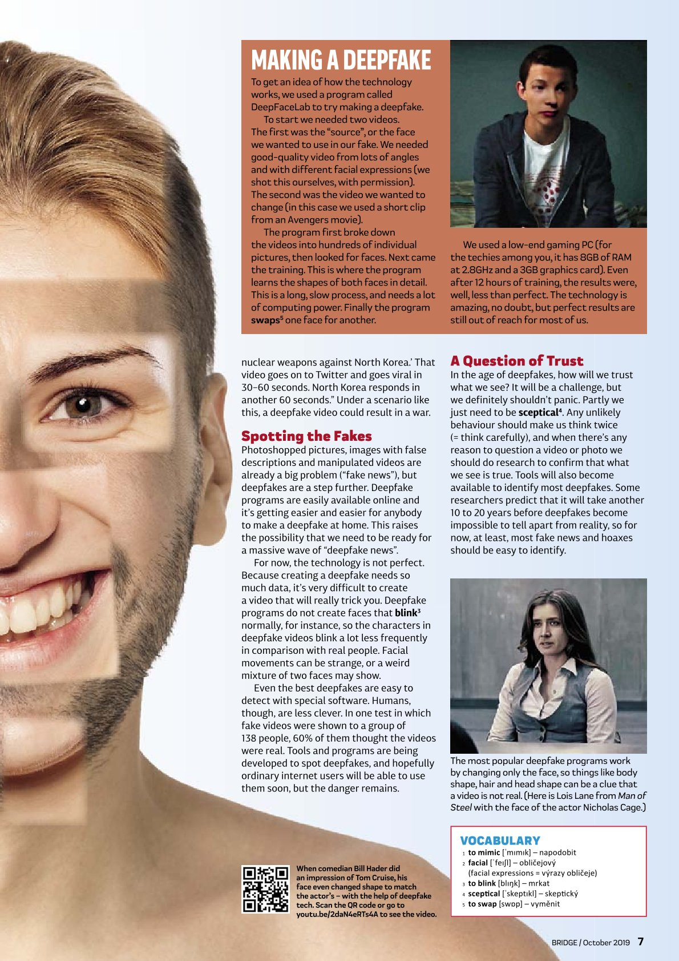
BRIDGE CZ A SK
Angličtina už nie je cieľom, ale prostriedkom.
Široký záber tém: aktuálne témy, reálie, sviatky a tradície, technológie, veda, literatúra, zábava, šport…
Hlbšie vedomosti a inšpirácia k diskusiám
Príprava na maturitu a jazykové skúšky - UKÁŽKA maturitnej stránky
Náročné jazykové hry, príbehy, komiksy…
“Bridge empowers young adults to use their growing English skills to engage fully with the outside world.”
Paul Farrington-Douglas (zástupce šéfredaktora BRIDGE)
Notes:
13

Slide 14
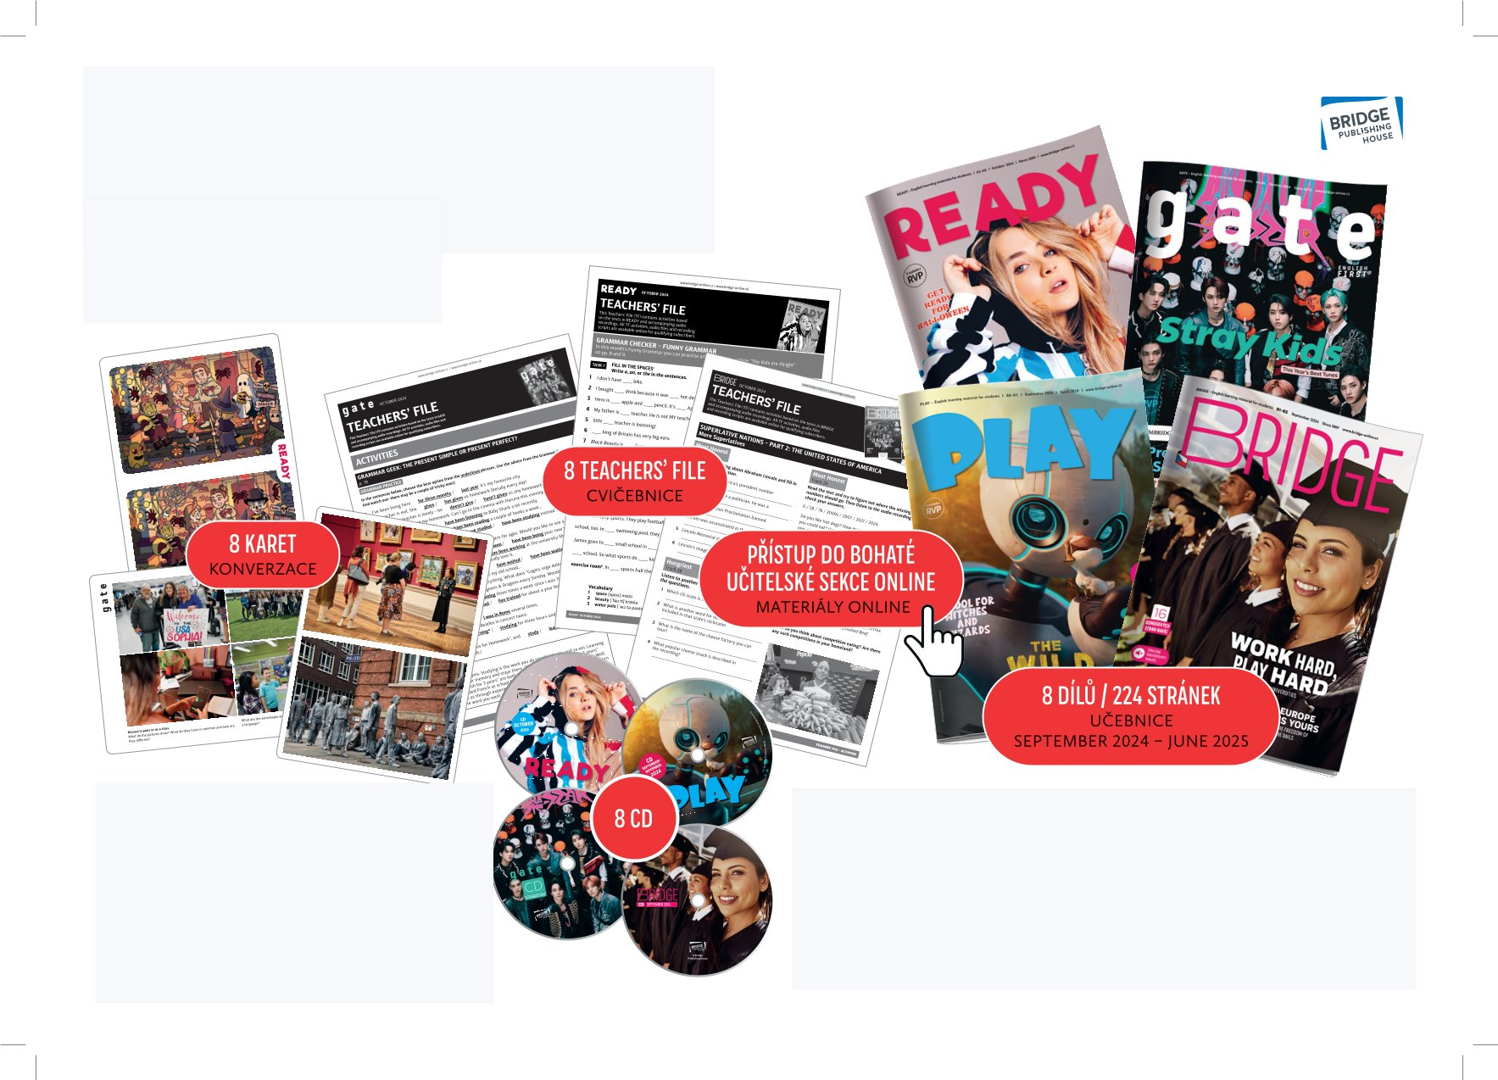
UČITEĽSKÝ BONUSOVÝ BALÍČEK
PODPORA PRE UČITEĽOV
Pre učiteľov objednávajúcich 11 a viac kusov predplatných.
KU KAŽDÉMU ČÍSLU (8x ročne)
RAZ ZA ROK
CD s posluchovými cvičeniami (8x)
konverzačná karta (8x)
Teachers’ File s doplnkovými aktivitami - cvičebnica (8x)
výtlačky časopisov naviac zdarma (8x)
prístup do bohatej online sekcie (napr. PDF verzie materiálov pre interaktívnu tabuľu, nahrávky článkov navyše, interaktívny TF, články navyše…) UKÁŽKA online podpory
vzdelávací plán na celý školský rok (ŠVP, SERR)
učiteľský stolný kalendár
výučbový plagát
Notes:
Zdůraznit, že je to SADA výukových materiálů na celý školní rok
Taková multimediální učebnice
Detailně popsat jednotlivé bonusy, ukázky?
Ukázka -
Podklady pro jedno číslo určitého titulu
Dalších bonusů: plakát, maturitní stránka,
14

Slide 15
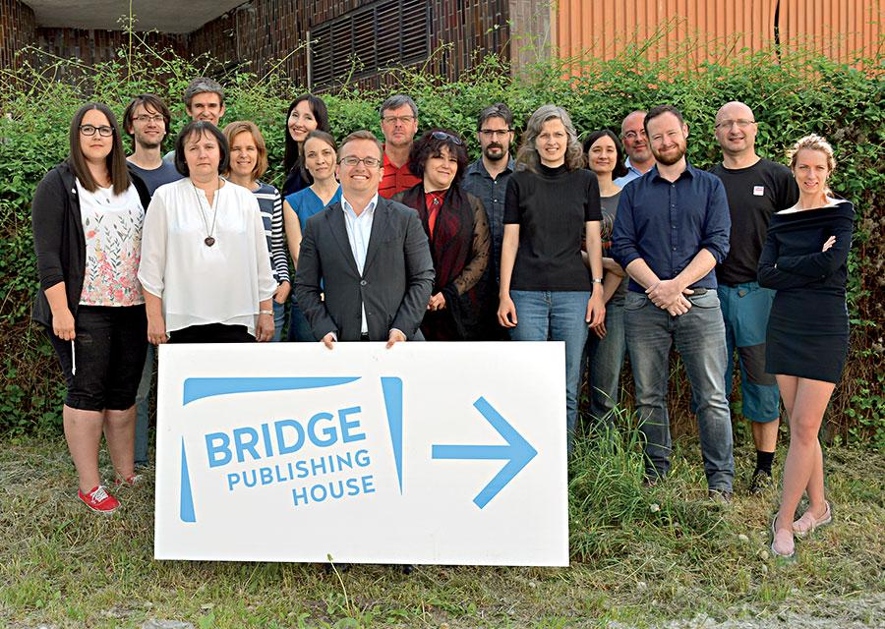
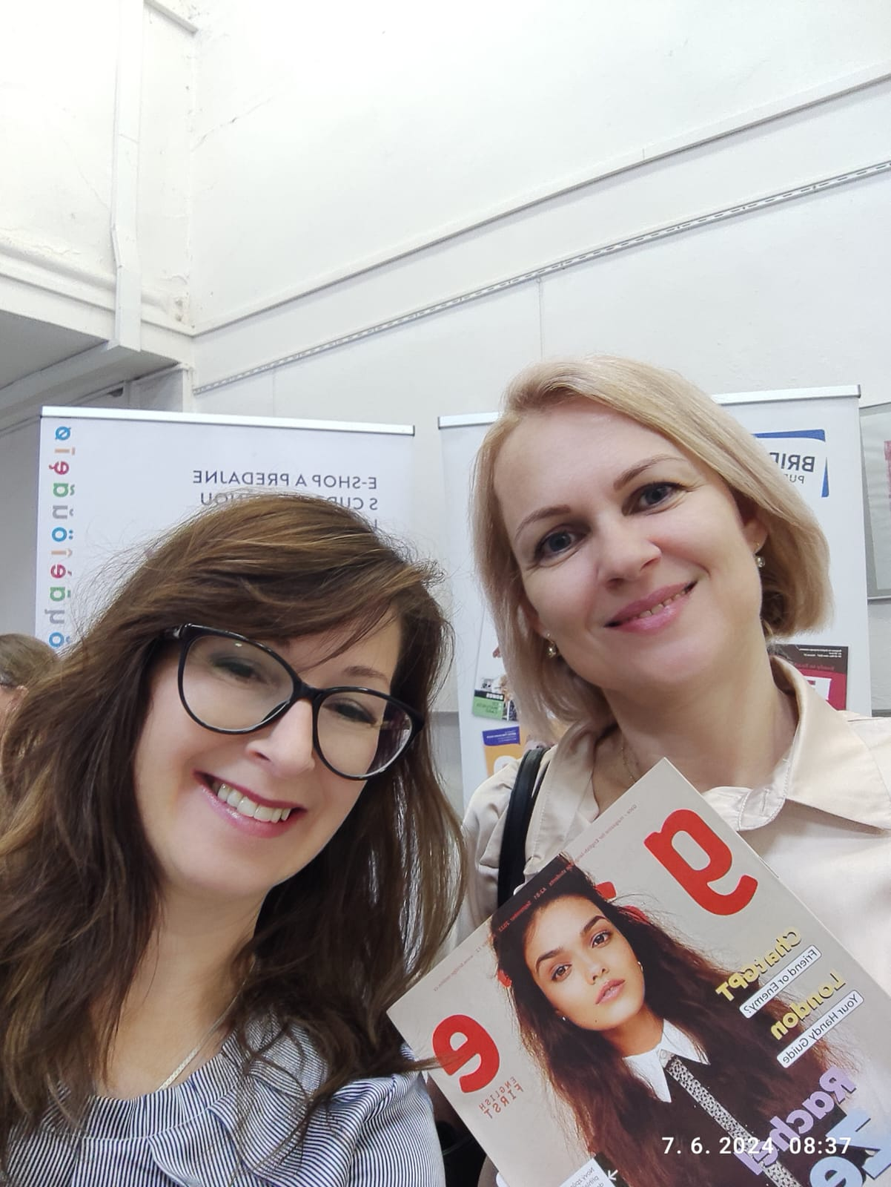
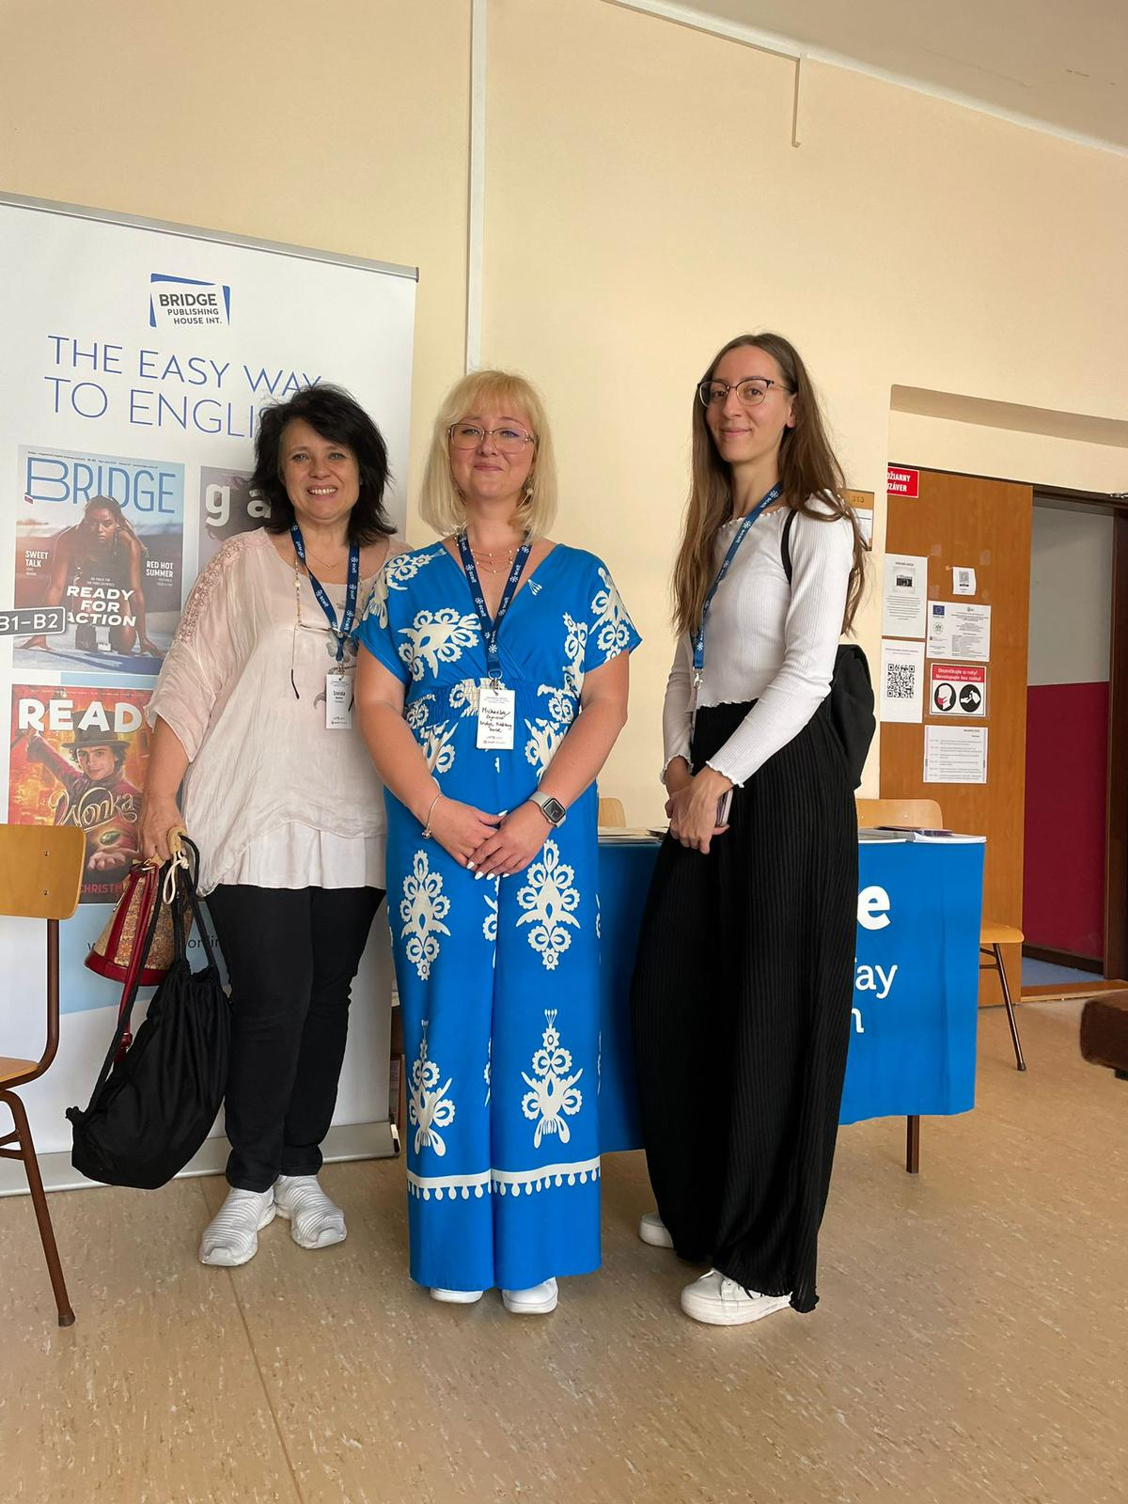

NÁŠ TÍM
4 redakčné tímy jednotlivých titulov: redaktori, metodici, interní anglicky hovoriaci autori a grafici
externí autori z mnohých anglicky hovoriacich krajín
spolupráca s expertmi v oblasti maturity (p. Prof. Jana Bérešová) a testovania (Cambridge)
Notes:
15

Slide 16

Naše tituly sú bez reklám a bez sponzorovaného obsahu!
To striktne dodržiavame.
Notes:
Jsme vzdělávací materiál. To je naše poslání. Příjmy pouze z předplatného.

Slide 17

CENA A SPÔSOB OBJEDNÁVANIA
Notes:
Vysvětlit pásma, počet předplatných, ceny, učitelský bonusový balíček, sleva
Počet bonusů podle počtu objednaných předplatných (viz slide 14)
Způsob objednávání - formulář, email, telefon
17

Slide 18

Nejaké otázky?
ĎAKUJEME ZA POZORNOSŤ! :o)
zajacova@bridge-online.sk
www.bridge-online.cz/sk
Notes:
18

Slide 19

Ako môžete prakticky využiť naše materiály na vyučovaní?
Ukážky práce s článkami

Slide 20

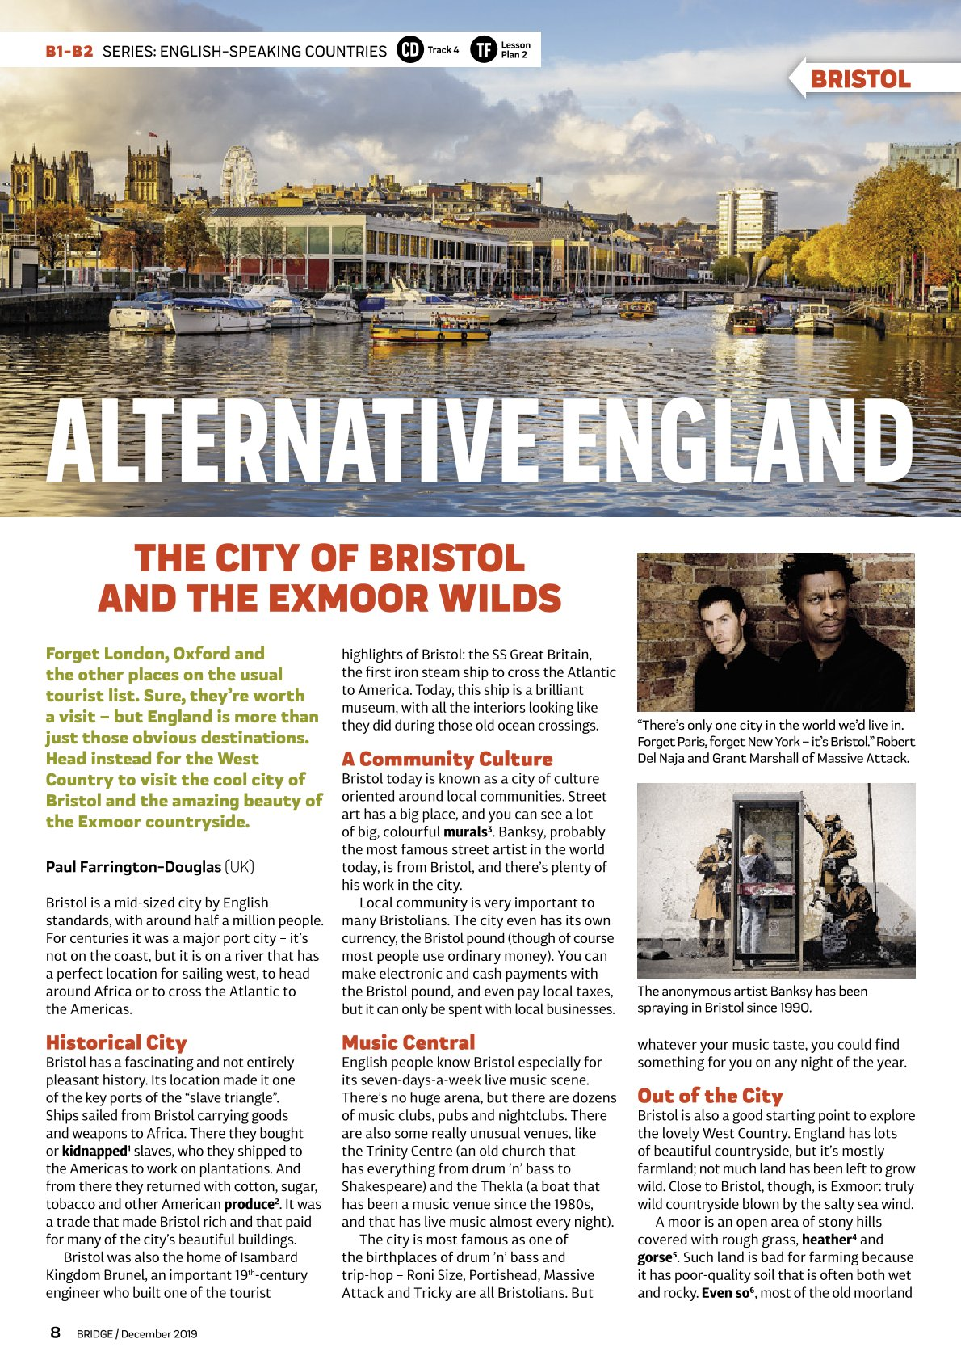
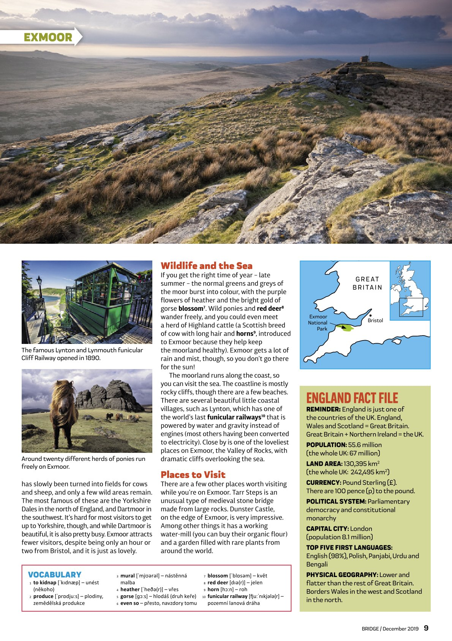
LESSON PLAN
B1-B2
45 min
England and the UK
Aims:
Revise basic knowledge about the UK
Learn and speak about 2 places of interest in England
Practise giving reasons
Notes:
Vysvětlit pásma, počet předplatných, ceny, učitelský bonusový balíček, sleva
Počet bonusů podle počtu objednaných předplatných (viz slide 14)
Způsob objednávání - formulář, email, telefon
20

Slide 21
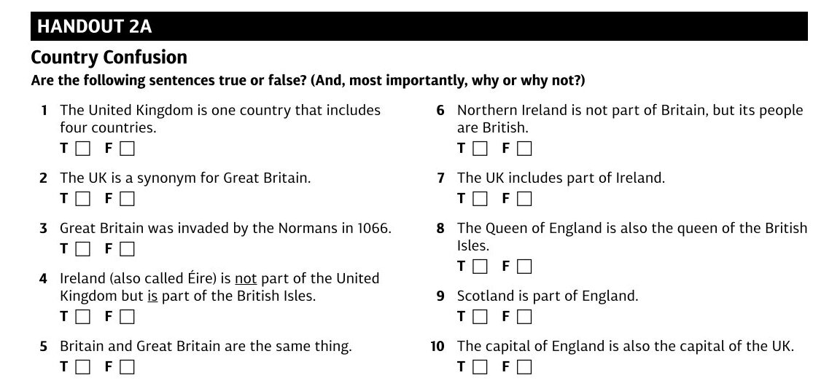
WARM UP 1
1-2 mins / 5-6 mins
Whole Class / Pair Work
SPEAKING
On the board: “the UK”, “Great Britain”, “Britain”, “England”, “Wales”, “Scotland” “Ireland”, “the Republic of Ireland”, “Northern Ireland” and “The British Isles” + a blank map of the British Isles
Ask the whole class to stand up. Say, “If you are not sure where Wales is on this map, sit down.” Choose one of the standing students at random to point out Wales on the map. Repeat for each of the terms.
A) If you get to the end and most Ss are still standing, you can ignore HANDOUT 2A and skip to Warm-Up 2.
B) Put Ss into pairs and distribute HANDOUT 2A. Give the pairs a minute or two to do the quiz, then go through the answers as a class. At the end, elicit the correct definitions of the names on the board again.
Notes:
WARM UP 1
Write “the UK”, “Great Britain”,
“Britain”, “England”, “Wales”,
“Scotland” “Ireland”, “the Republic
of Ireland”, Northern Ireland” and
“The British Isles” on the board. Put
up a blank map of the British Isles.
Ask the whole class to stand up. Say,
“If you are not sure where Wales is
on this map, sit down.” Choose one of
the standing students at random to
point out Wales on the map. Repeat
for each of the terms. Next:
A) If you get to the end and most
students are still standing, you can
ignore HANDOUT 2A and skip to
Warm-Up 2. If you wish, though, you
can do the quiz anyway.
B) If you run out of standing
students, or if most of the students
are sitting down at the end, put
students into pairs and distribute
HANDOUT 2A. Give the pairs
a minute or two to do the quiz, then
go through the answers as a class. At
the end, elicit the correct definitions
of the names on the board again.
21

Slide 22
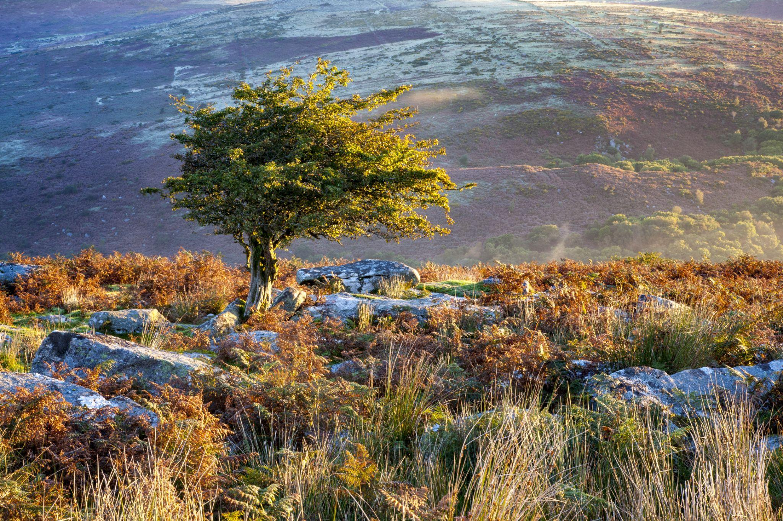

WARM UP 2 - PRE-READING
2-3 mins
Whole Class
SPEAKING | WRITING
Let’s speak about two places of interest in England.
What places of interest in England do you know?
Invite Ss to write the place names on the board to practise spelling. If Bristol [ˈbrɪstəl] and Exmoor [ˈeksmʊə(r)] don’t get mentioned, eventually mention them and have somebody write the words on the board.
Notes:
Solution:
Handout 2A 1T: In English, “country” is a rather vague term. England, Wales, Scotland and Northern Ireland are all countries. They are not “sovereign countries” though (i.e. independent countries). 2F: Great Britain is the name of the island that includes Scotland, Wales and England. 3F: England was invaded in 1066. “Great Britain” did not exist until the union of Scotland and England a few centuries later. 4T: The British Isles is a geographical term, not the name of a country. It includes the islands of Great Britain, Ireland, Man, Wight, Jersey, Guernsey, Shetland, Orkney and about 6,000 other little islands. The country Ireland (Éire) occupies most of the island of Ireland and is a republic. 5T: The Roman name for the island was Britannia. This became Britain. When the kingdoms of Scotland and England (which then included Wales) became one kingdom including the whole island of Britain, the king called the new political union “Great Britain”. 6T: Northern Ireland is part of the (political) country of the UK, not the (geographical) island of [Great] Britain. There’s no way to say someone is “United Kingdomish”, though, so citizens of the UK are “British.” 7T and F: The UK includes Northern Ireland, which is part of the geographical island of Ireland. There is a country called the Republic of Ireland (or Éire). This is not part of the UK, and if the UK leaves the EU (Brexit) it will still be part of the European Union. 8F: The Queen of England is also the queen of all the lands in the UK, but not of the Republic of Ireland (which is within the British Isles). 9F: Scotland and England are both part of the UK, but they are different countries (see the answer to 1). 10T: Each country in the UK has its own capital city – England’s is London, Scotland’s is Edinburgh, Wales’ is Cardiff and Northern Ireland’s is Belfast, but the capital of the whole UK is London.
22

Slide 23
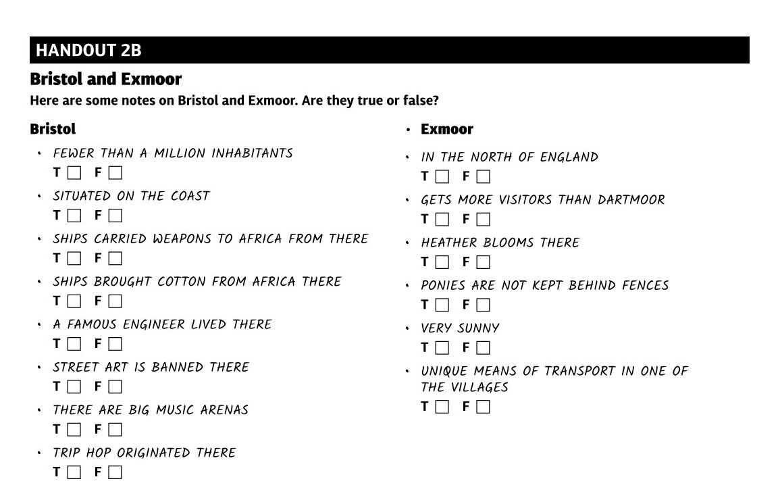
READING
10-15 mins
Individual Work
READING
Handout 2B. Give Ss some time to read it.
Ask them to read the “Alternative England” article (minus the “England Fact File”) and mark whether the notes in the handout are true or false.
Give feedback.
Notes:
Solutions: Handout 2B Bristol: T, F, T, F, T, F, F, T Exmoor: F, F, T, T, F, T
23

Slide 24


PRODUCTIVE SKILLS
6-10 mins
Group Work / Pair Work
SPEAKING | WRITING
Cut out the pictures from Handout 2C.
Put Ss into pairs or small groups, let each pair or group blindly pick one of the pictures.
Let each pair/group pass their note to the pair/group next to them. Each pair/ group ends up with a note written by somebody else.
Do you agree with the note?
Each pair/group should read the note aloud and say if they agree or if they remember something different from the article.
Notes:
Solutions: Handout 2B Bristol: T, F, T, F, T, F, F, T Exmoor: F, F, T, T, F, T
24

Slide 25

GIVING REASONS
4-8 mins
Pair Work
SPEAKING | WRITING
On the board: I’d like to go to Bristol…; I’d like to explore Exmoor…; In Bristol, I wouldn’t like to…; I’d worry about visiting Exmoor…
Ss should finish the sentences by giving reasons.
Ask them which conjunctions we use to give reasons. Try to elicit because, since, as, due to.
Do feedback by asking various Ss to read their sentences aloud. Afterwards, you may revise how the conjunctions are used.
Notes:
Because, since and as can be used at the beginning or in the middle of a sentence. If we want to follow because with a noun, we must use because of. Due to can also be used at the beginning or in the middle of a sentence. It must be followed by a noun. If we want to follow it with a clause, we must use due to the fact that.
25

Slide 26
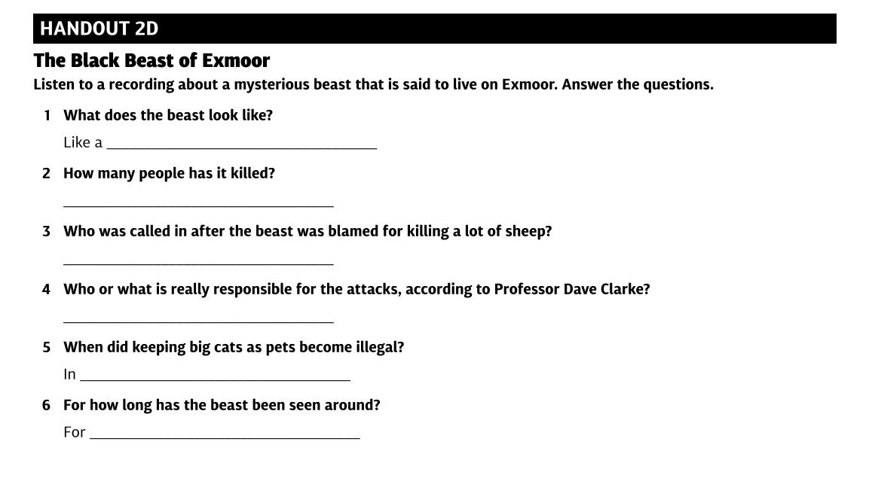

LISTENING
8-10 mins
Individual Work
LISTENING
Tell Ss that they are going to learn about a mysterious creature that is said to live on Exmoor. Ask them what it could be.
Distribute HANDOUT 2D and play track 7 once or twice. Do feedback.
You can also ask what other mysterious creatures students know (e.g. the Loch Ness monster, Bigfoot, Chupacabra, the yet…).
Notes:
Handout 2D 1 a puma or a big cat 2 none 3 army / soldiers 4 (large) dogs 5 1976 6 40 years
26

Slide 27


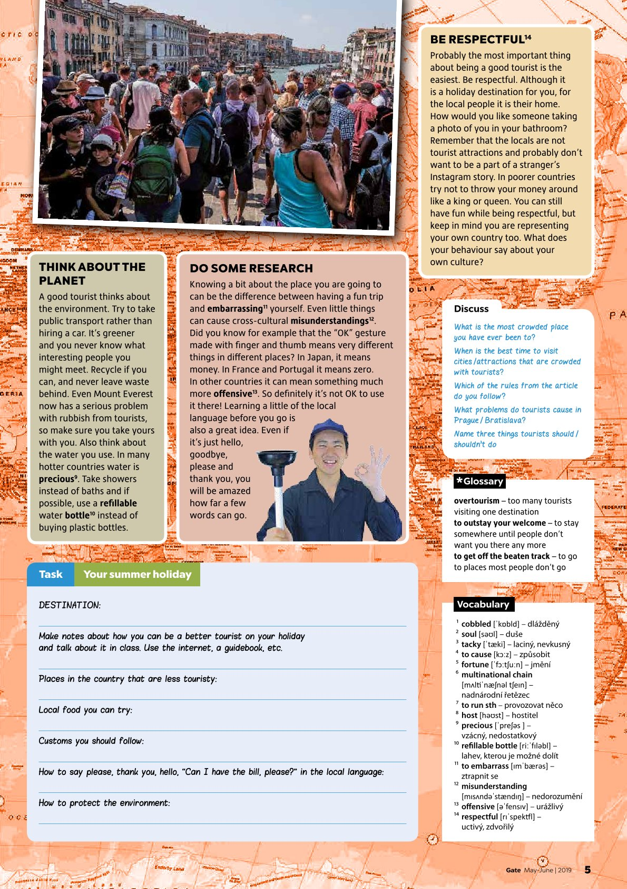
LESSON PLAN
A2-B1
45 min
Travel, Negatives of Tourism, How to Be a Good Tourist
Students will:
speak and read about problems with
overtourism
read about how to be a better tourist
listen to a conversation between two tourists and a waitress in Prague
Notes:
27

Slide 28
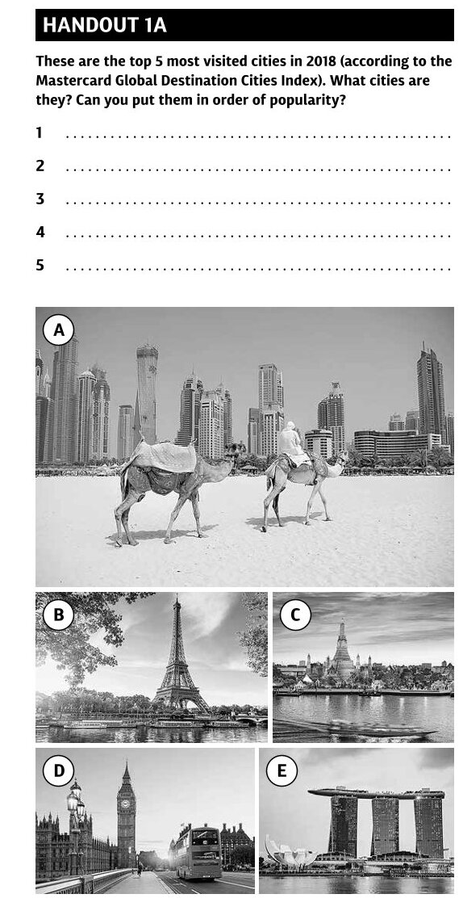
WARM UP
15 mins
Group Work
SPEAKING
Students in small groups. “What do you think the most visited cities in the world were last year? Agree on a top five and present your choices.”
Handout 1A - the solution. “Can you identify the cities? Put them in the correct order of popularity.”
Write “overtourism” on the board. “What does it mean? Can you think of any problems that overtourism could bring?”
Notes:
Solution 1A: 1A: The cities in the pictures are: Dubai, Paris, Bangkok,
London, Singapore. The correct order of popularity is (2018): 1 Bangkok, 2 London, 3 Paris, 4 Dubai, 5 Singapore;
Overtourism - (too many tourists visiting one place).
28

Slide 29
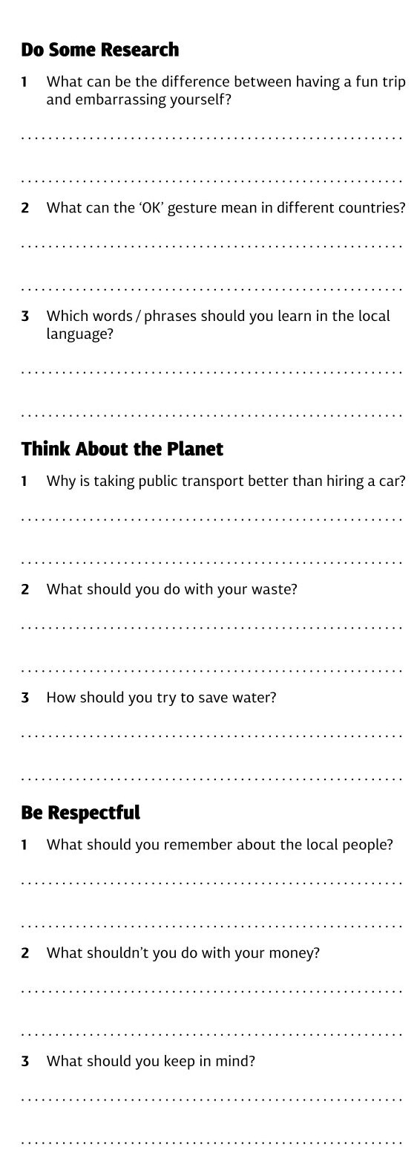
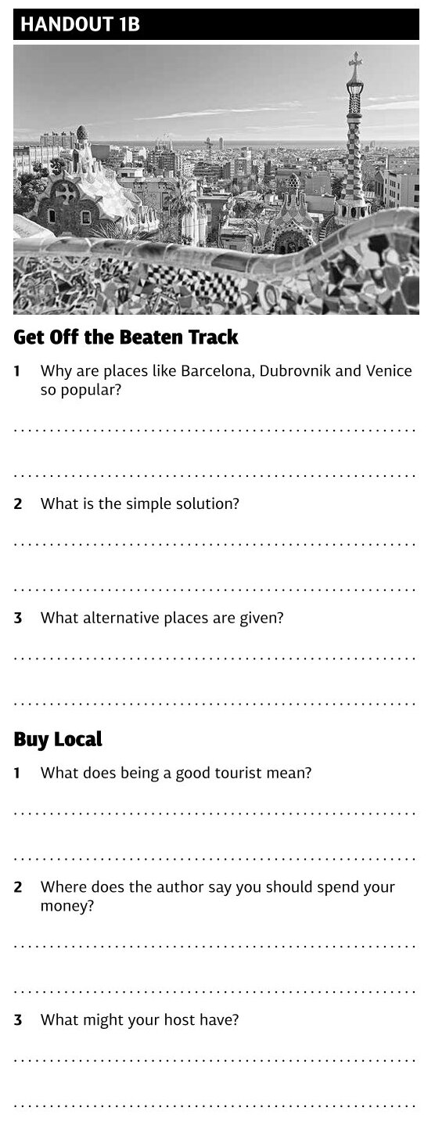
READING
10-15 mins
Group Work
READING, SPEAKING, LISTENING, WRITING
Pick a couple of Ss to read aloud the introduction and the first paragraph. Compare the information to the previous discussion.
Put Ss into groups of five and assign each group a paragraph from the article. “Answer the questions in the relevant part of Handout 1B.”
Make new groups, each containing at least one S from each of the previous groups. Ss ask and answer questions in the new groups to complete the handout.
Notes:
Solution: Off the Beaten Track: 1 They are all beautiful, exciting, fascinating places to visit, 2 don’t go there, especially during the tourist season, 3 instead of Venice – Treviso, instead of Barcelona – Girona or Tarragona; Buy Local: 1 Thinking about who you give your money to, 2 in local restaurants, in smaller places run by local people, 3 tips for less well known places and activities; Do Some Research: 1 Knowing a bit about the place you are going to, 2 In Japan – money, in France and Portugal – zero, in other countries it’s much more offensive, 3 hello, goodbye, please and thank you; The Planet: 1 It’s greener and you never know what interesting people you might meet, 2 recycle it if you can, never leave it behind, 3 take showers instead of baths and use a refillable water bottle; Be Respectful: 1 They are not tourist attractions and probably don’t want to be part of a stranger’s Instagram story, 2 throw it around like a king or queen, 3 you are representing your own country too
29

Slide 30
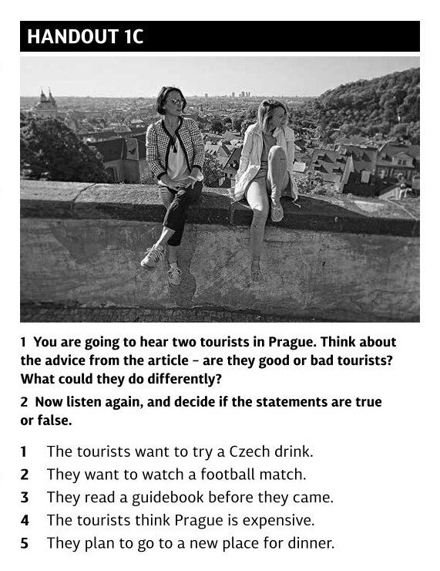
LISTENING
15 mins
Group Work
LISTENING, SPEAKING,, WRITING
“You are going to listen to two tourists in Prague.”
Play the track once.
Ss in small groups. “Discuss how the two men could be better tourists based on the advice in the article.”
Check the ideas as a class. Then play the track again and have the Ss decide whether the statements are true or false. Check the answers as a class.
Notes:
Solution: 1C: 1They are definitely not good tourists. They don’t know any of the local language, they don’t want to try any Czech food or drink nor experience Czech culture – Sparta vs Slavia football match. They didn’t do any research before they came and don’t even know what the Old Town Square is. They talk about how rich they are and generally don’t show any respect; 2 1F, 2T, 3F, 4F, 5F
30

Slide 31
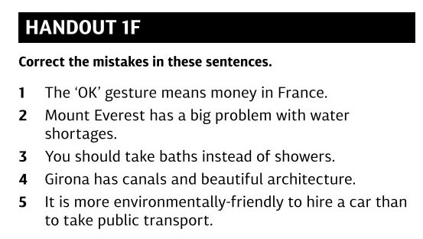
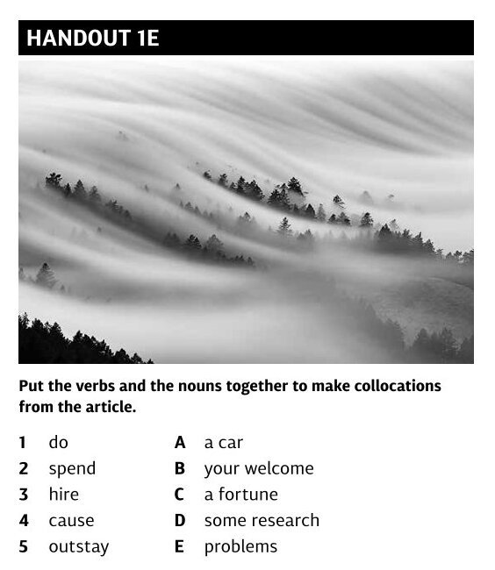
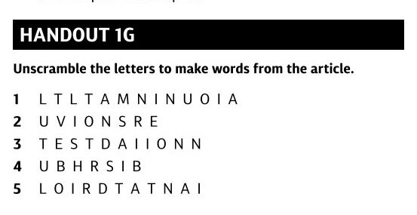
HOMEWORK + TASKS FOR EARLY FINISHERS
WRITING
“Think of a popular tourist destination in your country or somewhere else. Now try to think of an alternative place that tourists could visit instead. Do some research and write what the new place has to offer and why tourists should go there instead of the crowded destination.”
Not more than 200 words.
Notes:
Solution: Off the Beaten Track: 1 They are all beautiful, exciting, fascinating places to visit, 2 don’t go there, especially during the tourist season, 3 instead of Venice – Treviso, instead of Barcelona – Girona or Tarragona; Buy Local: 1 Thinking about who you give your money to, 2 in local restaurants, in smaller places run by local people, 3 tips for less well known places and activities; Do Some Research: 1 Knowing a bit about the place you are going to, 2 In Japan – money, in France and Portugal – zero, in other countries it’s much more offensive, 3 hello, goodbye, please and thank you; The Planet: 1 It’s greener and you never know what interesting people you might meet, 2 recycle it if you can, never leave it behind, 3 take showers instead of baths and use a refillable water bottle; Be Respectful: 1 They are not tourist attractions and probably don’t want to be part of a stranger’s Instagram story, 2 throw it around like a king or queen, 3 you are representing your own country too
31

Slide 32
AKO POMÁHA READY MOTIVOVAŤ MLADŠÍCH ŽIAKOV?
EFEKTÍVNE ČÍTANIE
jazyk
témy
obrázky & ilustrácie
4 zručnosti
precvičovanie
literatúra & komiksy
DRUHY TEXTOV
slová + samostatné vety
konverzácie
kreslené seriály
články / rozhovory
cvičenia, hádanky/ hlavolamy, hry
Notes:
How do we make reading for children possible and efficient? How do we make sure students at this level can benefit from reading? How do we help them?
LANGUAGE
We make sure that the most of the texts are authentic written by English-speaking writers.
A1–A2 level – it's challenging for the English-speaking writers, they are trained to do that: short sentences, short paragraps, vocabulary and grammar at the right level, vocabulary section if needed
TOPICS
a vocabulary topic for each issue based on RVP: e.g. food and drink, house, clothes, family, body, etc... connected with some seasonal topics: Halloween, Thanksgiving, Christmas, Easter, autumn, winter, spring, etc...
feedback forms
Which topics do you think your students prefer?
Which topics do you prefer?
favourite students' topics: comic strips, films, animals, sports, computer games, puzzles, songs
favourite teachers' topics: English-speaking countries, traditions and holidays, everyday English, songs, CLIL topics (science, etc...), tests: Cambridge YLE
PICTURES & ILLUSTRATIONS
they help present the vocabulary, understand the texts, make the texts more engaging and interesting for students
We try to make the texts as visual as possible.
comic strips + puzzles
4 SKILLS
We don‘t focus only on reading.
We make sure there‘s enough listening practice involved. A CD every month. Listening activities support reading: some written texts are recorded, conversations, listening activities, comics,…
We cover productive skills as well: speaking and writing, mainly in order to practise reading comprehension, Speaking and writing tasks motivate pupils to work with the texts more profoundly.
EXTENDED PRACTICE
Related activities in vocabulary, grammar, comprehension questions, and discussion increase the processing of the reading and boost student learning.
Each text in a magazine is accompanied by at least one comprehension activity:
A comprehension task (reading + listening + writing)
Vocabulary task
Grammar task
Class Chat – a speaking / discussion task
Puzzles, Competitions
that's what children love + monthly competitions, a lot of great feedback
puzzles, word searches, crosswords, mazes, coding – puzzle activities with texts to check reading comprehension special puzzle pages every issue
A Year-Round RR competition – My Story in Pictures: to create a comic page, their original story
Methodology support – TF Activities, Lesson Plans, CD + Recording Scripts
LITERATURE
we adapt/simplify popular children books/stories into a comic strip + recorded as an audio comic (both reading and listening + pictures)
recommended reading list
Treasure Island by Louis Stevenson, Matilda by Roald Dahl, Viking stories, The Graveyard Book by Neil Gaimann, native legends
What types of texts are students at an elementary level able to read?
These are the types RR magazine covers:
Textbook structure of RR
the mag follows a textbook structure, from presentation of simple language to practice
articles which relate to the key vocabulary + some other topics + tasks (practising the 4 skills) + songs and puzzles
puzzles which practice the key vocabulary from the mag
The comic strips, articles and interviews are authentic texts written by English-speaking writers.
the presentation and practice of key vocabulary for that issue on pp. 4-5 – picture dictionary including key words and their usage in simple sentences, A1 level. We make sure it is as visual as possible. The choice of key vocabulary is based on the RVP for the 4th to 6th graders, roughly A1–A2 level of CEFR. It involves both reading and listening.
Conversations on p. 9 – the key vocabulary is presented and practised in a conversation together with some functional language, everyday phrases at A1 level. It involves both reading and listening.
Comic strips – focus on longer chunks of language, usually two or three sentences that are accompanied by pictures (obviously) and audio input. The language is authentic. It‘s usually based on a book. At least three pages in each issue.
Articles – written by native speakers – authentic texts written at A1–A2 level. They are structured into short and clear paragraphs with headlines.
Exercises, puzzles – practise key vocabulary, or topics the students are already familiar with…

Slide 33
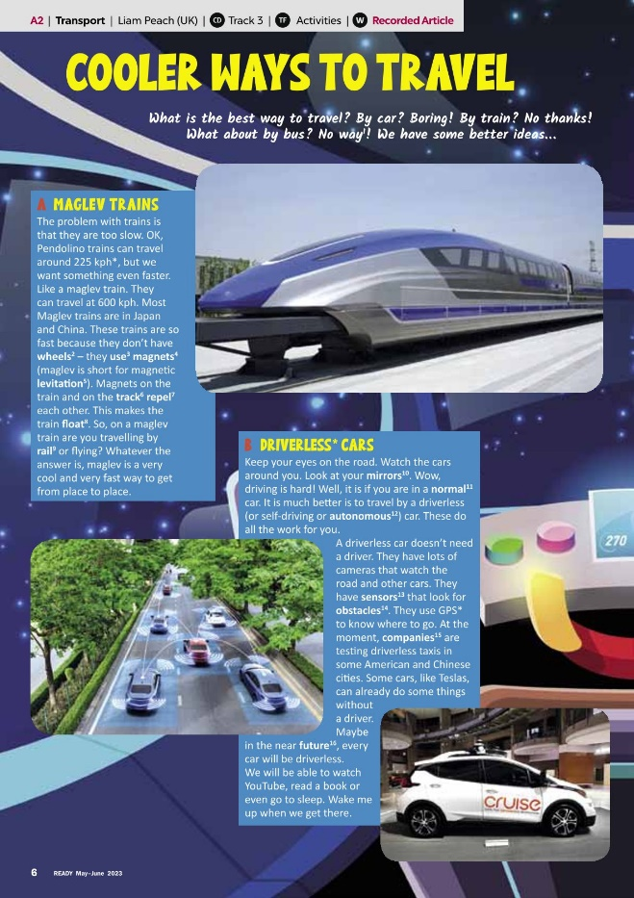
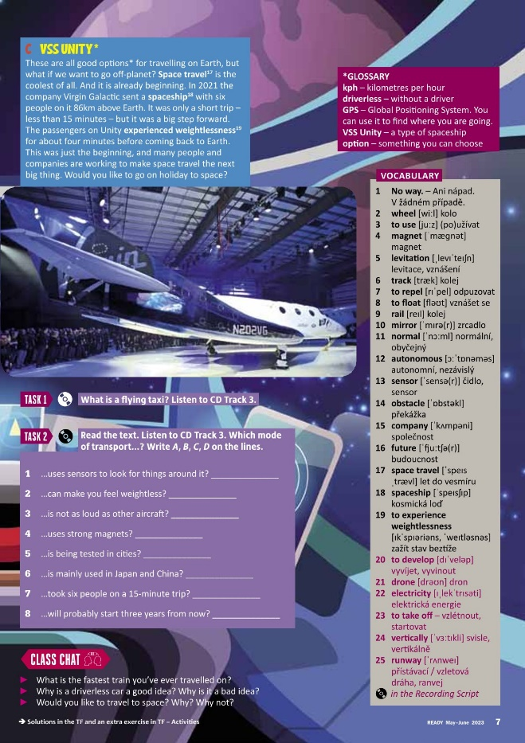
COOLER WAYS TO TRAVEL
(máj - jún 2023, str. 6-7)
Notes:
I‘ve picked an article from the April issue of RR to show you how to work with it + how to use the article and build a comprehensive lesson around it.
Do you know when Happy Earth Day is celebrated? Did you celebrate it this year?

Slide 34
PRE-READING = WARM-UP
TASK
slovná zásoba k téme:
zoznam, akronym, kľúčové slová, spájanie obrázkov so slovami, výber správnych slov, slovné asociácie
otázka:
What is maglev?
How do you travel to school?
rozhádzaná veta:
place-to-fast-to-is-from-maglev-get-very-place
dve pravdy a lož
tri spoločné veci
whose?
Notes:
What‘s warm-up for?
Warm-up: You put your students into English mode; get them attentive, interested and ready to participate. A warmer can also serve to review language from a previous lesson or prime the class for a new topic. – that‘s what we usually recommend.
Pre-reading task - introducting the topic of a text and key vocabulary before reading the, arousing expectations, own presonal experience , get them involved and motivated to read, it also gives some some basic useful topic-related vocabulary
One of the basic pre-reading activities could be:
comprehesion questions / true-false questions which they can later check in the text
Look at the title, look at the pictures – can you guess the topic?
TASK 1
Write „the means of transport“ on the board, ask if any students know what it means. If so, have them explain it to the class.
Ask the students what what means of transport they use / like / dislaike /why...
Some other tips:
Topical vocabulary (the issue):
Acronym: t r a n s p o r t– initial letters
Key words: e.g. Driving cars, using water, using electricity – what do the words mean, guess the topic of the lesson
Choose the right words: various words on the board, which ones relate to „the topic“ (cupboard, pencil, to recycle, purple, plastic, bridge, water)
Odd one out – 4 tomatoes peas apples carrots
A question: „How do you travel to school?“ – guess the topic
Two truths and a lie – about one particular topic – a topic of the text they are going to read, or specific sentences from the text: „Potatoes are bad for the planet.“ „We don‘t need trees.“ „Fast food restaurants are bad for the planet.“
Three things in common – in pairs – three things we could do to help the planet…
Whose?
Give each student a slip of paper and ask each student to write down three things they do to help the planet / like about summer / most favourite sport / food / what they did at the weekend. Collect up the slips of paper and randomly read each one out. The students must guess whose paper is it.

Slide 35
READING
Rôzne stratégie čítania
(letmé čítanie x čítanie pre detail; celá trieda, v pároch,
v skupinách = ,,na preskáčku”)
Rôzne aktivity spojené s čítaním
otázky na porozumenie
výber z viacerých možností
True-False statements
spájanie začiatkov a koncov viet
dopĺňanie chýbajúcich údajov
oprava chýb
vety do správneho poradia
cvičenia na slovnú zásobu
TASK
TASK
Notes:
Reading strategies: we are trying to make sure we give the readers a variety of different types of reading tasks.
Skimming = reading for general understading, gist, e.g. key topics, main ideas „Is the text about plants and animals, or about summer?“
Scanning = reading for specific information: facts, names, numbers, dates
„Which food is bad for the environment?“
TASK 1 (a reading strategy – jigsaw reading)
Group Work
1 open the magazines at page 6. Let‘s read the introduction together and make sure everyone understands it well. Now let‘s make groups. Each group reads one of the three parts: Greenhouse Gases, Bad Food for the Earth, or Good Food for the Earth.
They should work together to look up and translate any unfamiliar words and make sure they understand the whole paragraph before continuing. Walk around the class, monitor their work and help them if necessary.
2 Fill in the section in the table that you have read about in Handout 2A . Then present the information to the rest of the class. The other students fill in the rest of their handouts with the information from the other groups. At the end, sum up the correct answers as a class.
3 Discuss what the worst thing for the environment is (farming animals for food / eating meat) and the reasons why (deforestation, methane, also meat isn't energy efficient, the farming creates carbon dioxide, etc.). Then read through the list of tips as a class.
TASK 2
Task on p. 7
a reading comprehension activity focused on scanning + vocabulary practice

Slide 36
POST-READING
ROZPRÁVANIE
problémy
Aktivity k čítaniu
otázky na porozumenie (CLASS CHAT)
ankety/ prieskumy
prezentácie
dialógy hraním úloh, kreslené príbehy, rozhovory
POČÚVANIE
dopĺňanie
oprava chýb
výber z možností
spájanie
PIESNE
HÁDANKY/ HLAVOLAMY & HRY
TASK
TASK
Notes:
Post-reading = follow-up tasks, for example: role-plays, discussions, writing tasks (writing a letter in reply), personalisation (Have you ever had an experience like this?)
In RR we usually include
a speaking activity,
the problem with the level: A1–A2,
Problems:
not enough language,
they are afraid to talk,
only one student talks,
they use their mother tongue
you can‘t ask them questions, and expect that they will discuss them freely with appropriate fluency,
they need some more structured input. You should avoid asking questions like: What do you think?
POSSIBLE SOLUTIONS
1 Not enough language: a lot of cues:
Topic of the article, reading article helps them think about the topics, it‘s a good lead-in
Key vocabulary from the article / some language structures
Structured task: organize whose turn it is, give them a lot of example sentences they can choose from
Allow them some preparation time: choose the example sentences you want to use, take notes, etc…
2 They are afraid: group work/pair work –
As a class – is easier to monitor and correct, only a few students talk
gives the students more opportunity to talk, they are not afraid, you need to help and monitor, don‘t interrupt, take notes
3 Motivation: topics of the articles (we choose appropriate topics for the age group) - personalisation
Listening – almost with every article in the magazine, we include different listening activities focused mainly on listening comprehesion: listening to conversations, key vocabulary, monologues, recorded articles printed in the magazine
Post-reading activity
Listening comprehension
Vocabulary revision
Fun & motivation
Puzzles and Games
Puzzle pages usually 3 to 4 at the end of every issue: very popular with students, we try to use them as much as possible, key vocabulary from pp. 4–5 and key words/structures from various articles, with
Vocabulary revision – key vocabulary from pp. 4–5 and key words from various articles
Grammar revision – structures which are presented in Everyday English (usually p. 8 or 9) / Grammar Fixer /
Reading comprehension – immediately after the articles
Fillers – at the beginning, as a warm-up, in the middle of a lesson as a way of changing the pace/mood, at the end when there‘s some extra time left
TASK 1: Handout 2B + 2C
1 Pair Work
Work in pairs and give each pair a copy of Handout 2B. The text is about a real student who is doing something to help the environment right now. Read the text and fill in the gaps with the words first, next/then and finally. Review these words if necessary. Then check the answers as a class, with a different student reading each sentence.
2 Group Work
you are going to learn more about how you can help the environment by doing small things that lead to big effects, like dominoes. Make groups and give each group one part of Handout 2C. In groups, arrange the cards in a logical order, then write out the sentences in order with connecting words like first and next or then.
3 Whole Class / Group Work
Present your domino sequence to the class. Make sure each student in the group gets a chance to speak.
TASK 2
SONG
Explain what „reduce“, „reuse“, „recycle“, then match them with the sentences on the right, then the song
CD Track 14

Slide 37
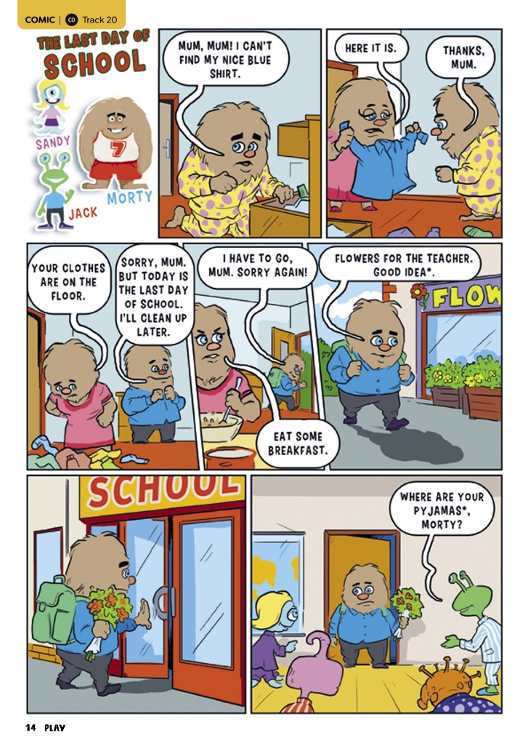
AKO POMÁHA PLAY MOTIVOVAŤ
MLADŠÍCH ŽIAKOV?
časopisy sú zábavné! vs. učebnice
komiksy, hry, hádanky/ hlavolamy, DIY…
rozpoznateľné postavy a súčasné témy
kreatívne a ,,hlúpe” úlohy
precvičovanie gramatiky a slovnej zásoby hraním úloh
úlohy na počúvanie
grafické prevedenie
Notes:
How do we apply the previously described principles in the Play magazine?
How PLAY can foster and restore intrinsic motivation to your students?
Children see magazines as inherently fun and not as educational. Grammar and vocabulary practice in the context of fun activities: games, puzzles, stories, DIY… Young learners learn without being aware of it.
The magazines contain recognizable characters to draw students' interest, for example Minecraft, Pokemon, the Addams Family characters
Creative and silly tasks let students use their imagination and share things they don't often get to talk about at school.
Role-playing exercises teach practical grammar and vocabulary but are framed in ways that make them fun instead of boring, the way many textbook exercises feel. Drama.
There are a lot of listening tasks - the tasks appeal to more senses: visual and aural
Working with hands: colouring, cutting

Slide 38
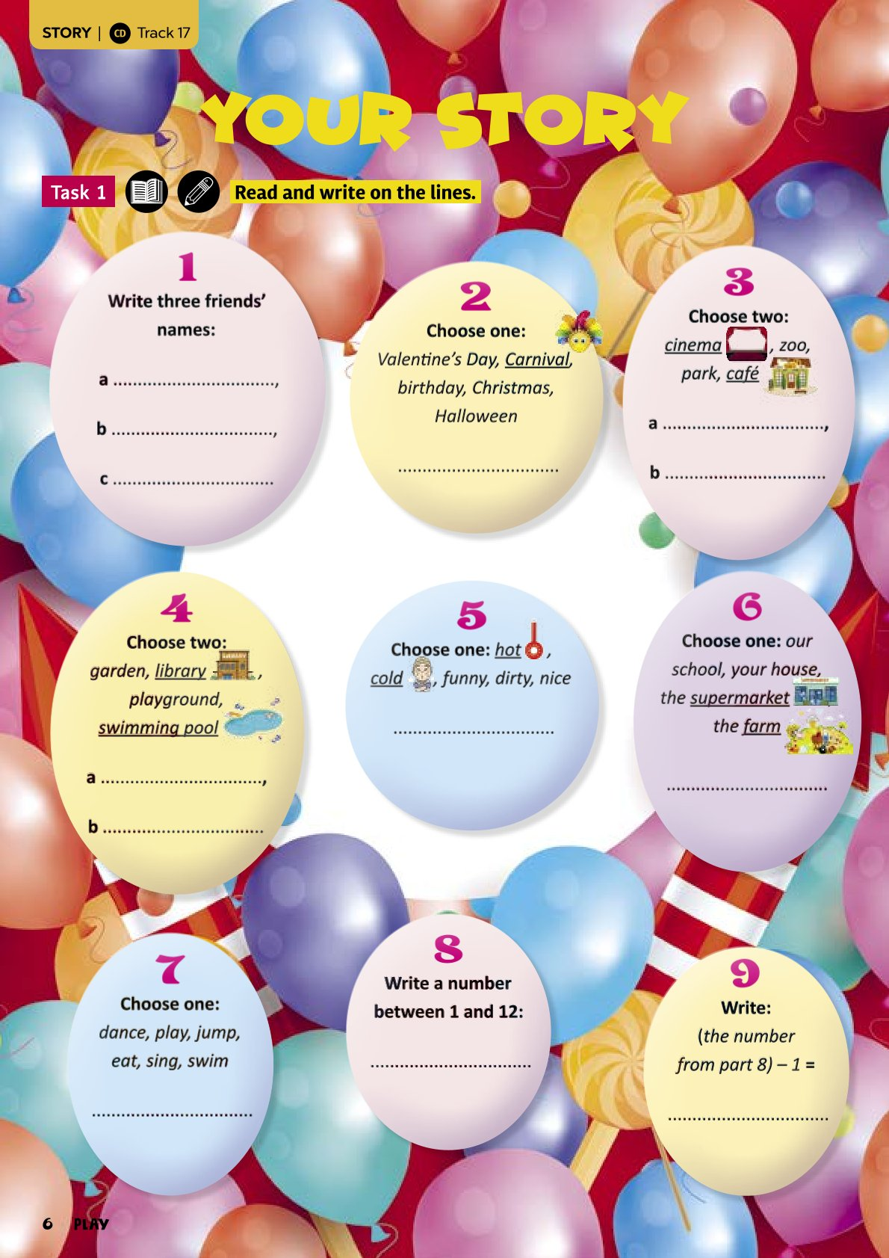
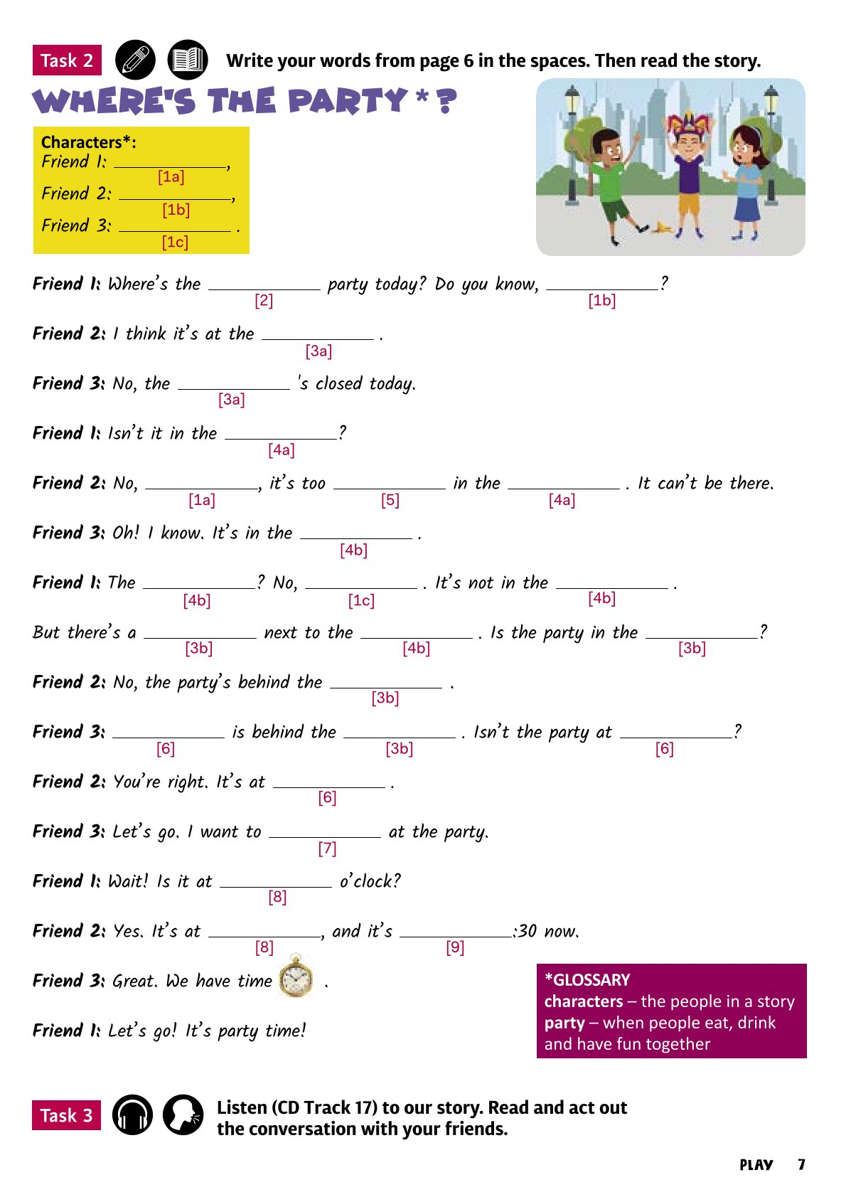
Prípadová štúdia 1: DOPLNENIE PRÍBEHU
(január - február 2025, str. 6-7)
Notes:
How do you think this task fosters intrinsic motivation?

Slide 39
PRÍPADOVÁ ŠTÚDIA 1: DOPLNENIE PRÍBEHU
deti milujú rozprávanie príbehov a zábavu
kreatívna sloboda so štruktúrou -
sebadôvera
pre žiakov 1. aj 2. stupňa
gramatika a gramatické pojmy precvičované spolu (podvedome)
zahrnuté počúvanie
zábavná situácia formou hrania úloh - zahŕňa rozprávanie a hranie
zlepšuje plynulosť
Notes:
Young learners might be motivated to tell stories but lack the skill to do so effectively in English.
Introverted students in particular might be afraid to try to tell a story if they're not confident that they can do it without mistakes.
These stories give students creative freedom while also providing a structure.
Grammar terms are present on the page and useful for finding the right categories of word, but don't need to be addressed directly. Students will gradually start to learn and remember the meanings of words like "noun" and "adjective" passively.
Students with a greater English vocabulary can be invited to use words not on the lists, while lower-level students have plenty of choice and needn't fear now knowing enough words.
Once familiar with the structure, students can even be invited to write their own Mad Lib stories with lists of words to share with the class.

Slide 40
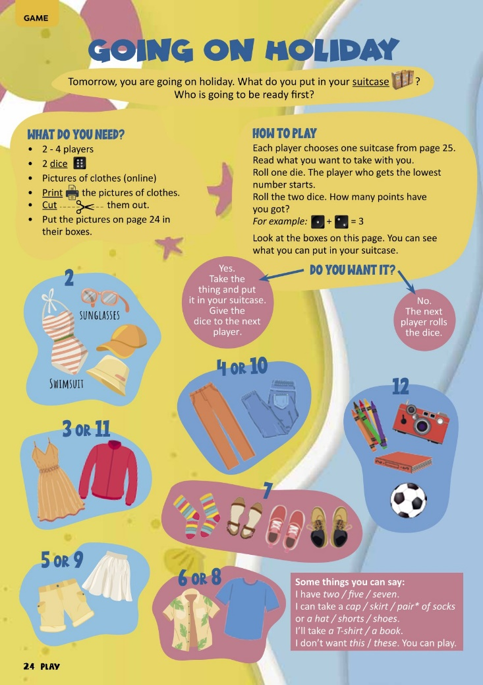
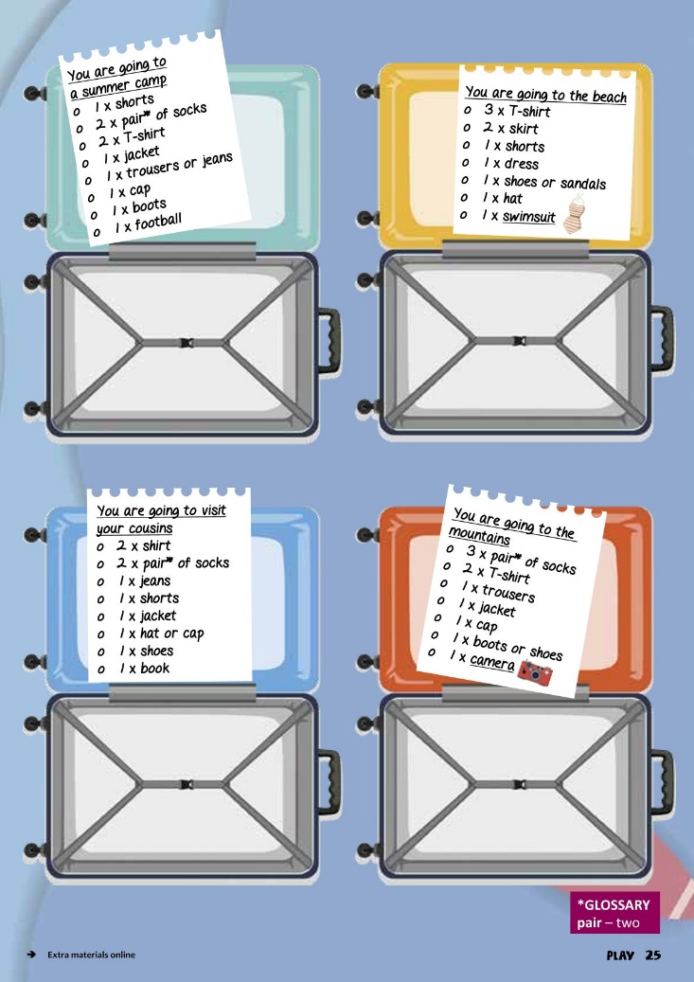
PRÍPADOVÁ ŠTÚDIA 2: STOLNÁ HRA
(máj - jún 2023, str. 24-25)
Notes:
How do you think this task fosters intrinsic motivation?

Slide 41
PRÍPADOVÁ ŠTÚDIA 2: STOLNÁ HRA
hry – najefektívnejšie motivačné nástroje
spolupráca a súťaž
rozprávanie a používanie angličtiny – len nástroj hry
precvičovanie gramatiky a slovnej zásoby spolu
Notes:
Games are one of the most effective tools for motivation, especially in a classroom where "playing" is often discouraged.
All people have instincts for competition as well as cooperation.
This particular board game is about competition. Trying to win the game and beat their classmates is sure to motivate the students.
Speaking and using English becomes something they want to do so they can play the game effectively, rather than something they have to do because they're forced to.

Slide 42
Nejaké otázky?
ĎAKUJEME ZA POZORNOSŤ! :o)
Notes:
42

